Slide 1






Shannon-Fano Algorithm
Michelle Orru

Slide 2

01
Introduction
02
Category
Topics Covered
03
Description
INDEX
04
Purpose
05
Complexity

Slide 3
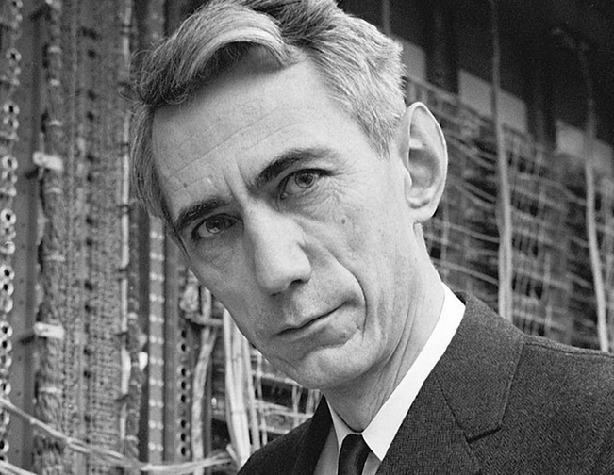
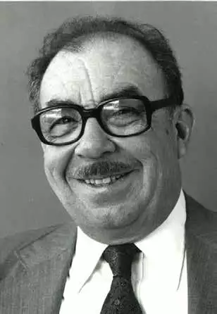
Introduction
Background
The Shannon-Fano algorithm was developed by Claude Shannon and Robert Fano in the late 1940s
This algorithm was used as a data compression coding technique
It uses the probabilities of the repetition of characters and assigns a unique code to them
The least frenquent characters get assigned longer codes and the most repeated ones gets a shorter code
ROBERT FANO
CLAUDE SHANNON

Slide 4
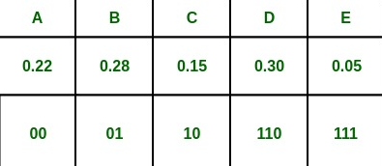

Category
Category of the Algorithm
CATEGORY: RECURSIVE ALGORITHM
The Shannon-Fano algorithm is classified as a recursive algorithm. It operates by repeatedly splitting the set of symbols into two subgroups, until each subset consists of just one subtree. The algorithm calculates ...
... the probability of each symbol in the subset at each step of the recursion and then assigns a binary code to each symbol. This is constructed by appending a "0" or "1" to the assigned character.

Slide 5
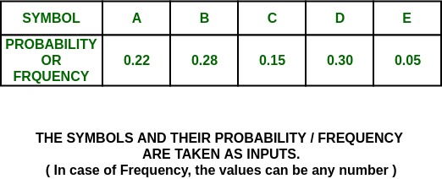
Description
Steps of the Algorithm
Calculate the probability of each symbol in the message.
Sort the symbols in decreasing order of probability.
Divide the set of symbols into two subsets such that the sum of the probabilities of the symbols in each subset is as close as possible to half the total probability.

Slide 6
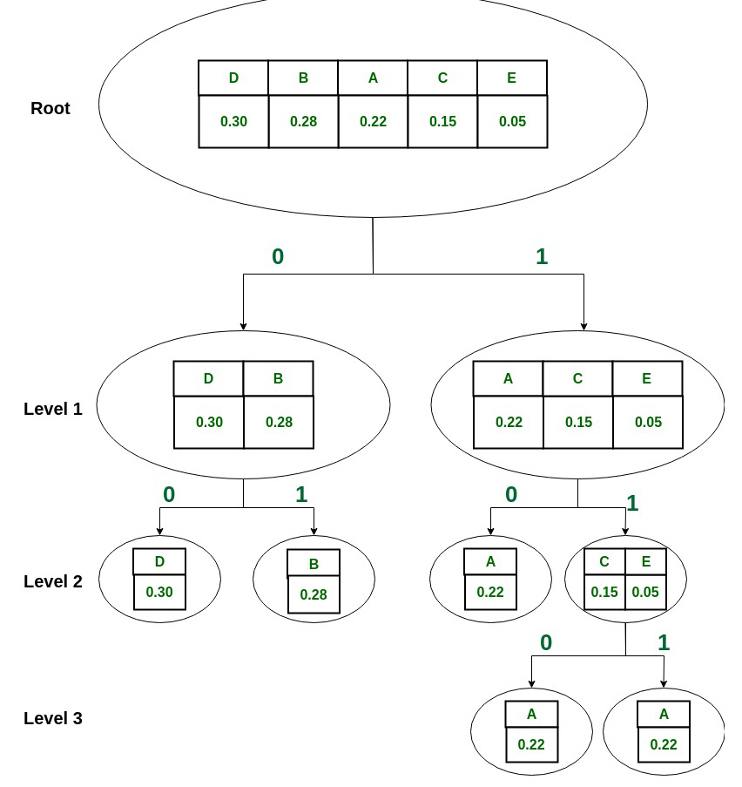
Assign a '0' to all symbols in the first subset and a '1' to all symbols in the second subset.
Repeat steps 3-4 recursively for each group until each group contains only one symbol.
Repeat steps 2-3 recursively on each subset until each branch contains only one character.
Concatenate the codes assigned to each symbol to form the compressed message.

Slide 7

Purpose
Purpose of the Algorithm
The main purpose of the Shannon-Fano algorithm is to create a prefix code, where no code word is a prefix of any other code word, for a set of symbols with associated probabilities of occurrence.
It encodes a message in a way that requires the least amount of space possible, while assigning variable-length codes to symbols, such that the most frequent symbols are assigned shorter codes, and the least frequent symbols are assigned longer codes.

Slide 8
ADVANTAGES OF THE ALGORITHM
DISADVANTAGES OF THE ALGORITHM
Advantages and Disadvantages
No information is lost during compression
It is effective in compressing data with high redundancy, resulting in significant reduction in file size.
It is simple to understand, making it suitable to use where computational resources are limited.
it may not be as effective in compressing data with low redundancy.
It requires the probability of each input symbol, which may not be accurate.
It compresses data without losing any information so it's not suitable for data such as in image or video.

Slide 9

Complexity
Time and Space complexity of the Algorithm
O(n log n)
The TIME COMPLEXITY is O(n log n), where n is the number of characters. This measures the time to sort each symbol.
O(n)
The SPACE COMPLEXITY is O(n), as it requires storing the probability and code for each symbol.

Slide 10
Thank you!

